Slide 1
Characteristics of Life
Six Characteristics all living things share

Slide 2
Name some living things.
Why are they living?

Slide 3
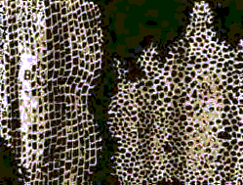
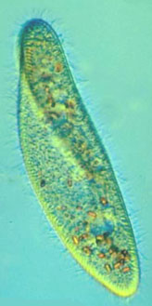
1. Cellular Organization
Organism – any living thing
Cell – basic unit of structure and function in all living things
  Unicellular – one celled
  Multicellular – more than one cell

Slide 4
2. Similar Chemical Make Up
Chemical Compound
Purpose
Water
Carbohydrates
Proteins and Lipids
Nucleic Acids
Medium for chemical reactions
Cell’s main energy source
Building materials of cell structures
Genetic Material

Slide 5
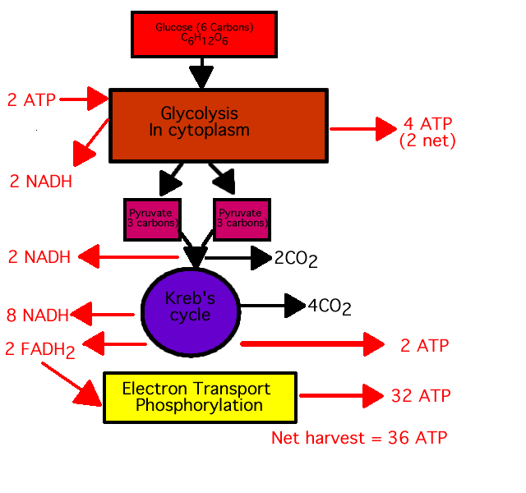
3. Energy Use
We use energy for everything!!!

Slide 6

4. Response to surroundings
Stimulus – any change in an organism’s surroundings that causes a reaction
Response – an action or change in behavior

Slide 7
5. Growth and Development
Growth means getting bigger or adding parts
Development means there is a change that occurs over the organism’s life

Slide 8
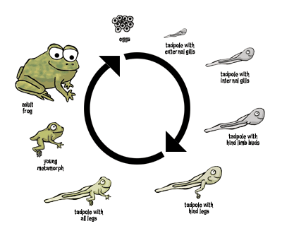

Slide 9
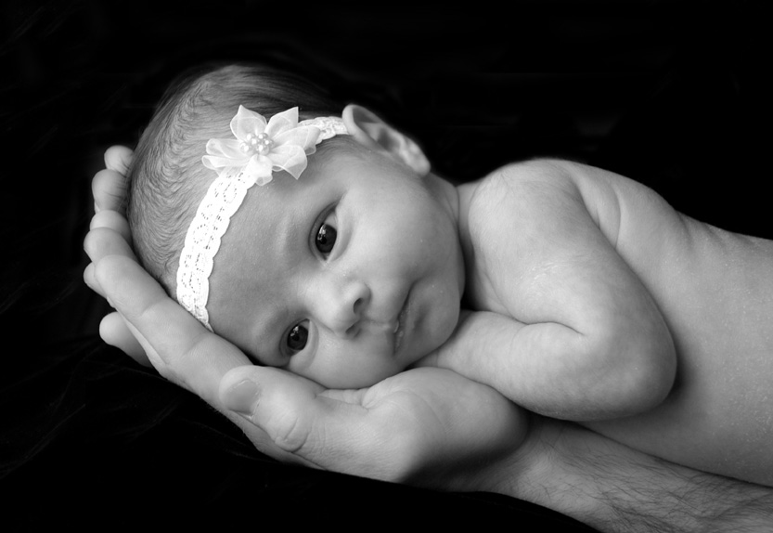
6. Reproduction
The ability to produce offspring that are similar to parents

Slide 10
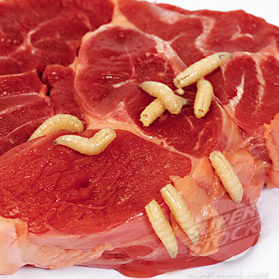
Francesco Redi
Spontaneous Generation – the idea that living things come from non-living things
Biogenesis - Life comes from preexisting life

Slide 11
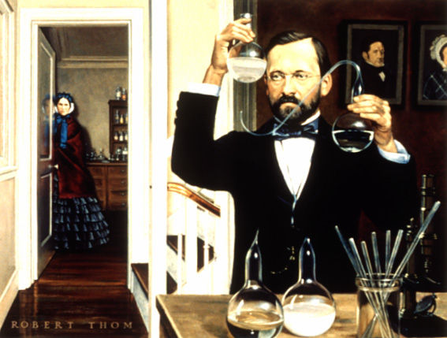
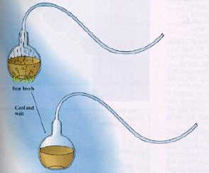
Louis Pasteur

Slide 12
Needs of living things

Slide 13
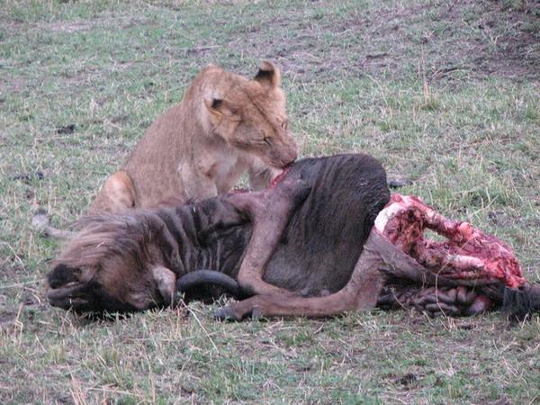
Four Basic Needs
Water
Food
  Autotroph - organisms that make their own food (plants)
  Heterotroph – organisms that obtain food by eating others (most)

Slide 14
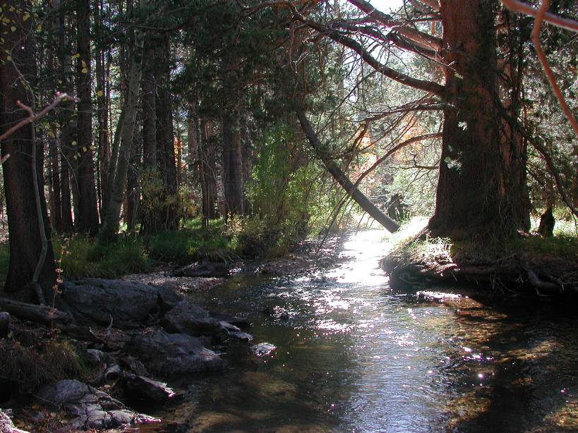
Four Basic Needs
Living Space
Stable Internal Conditions
  Homeostasis – the maintenance of stable internal conditions

